Slide 1
Lab Training Summer Term 2022​
Embedded Systems​
Task 3 - Arduino based Binary clock and Stop watch​
​

Slide 2
Requirments of the project
Req_001: This project is realized using Arduino UNO.
Req_002: Representing Clock in Binary format using different colored LEDs.
Req_003: The Binary clock should be in HH.MM.SS format.
Req_004: Addition to the Binary clock, it should include stop watch feature.
Req_005: Stop watch should support Pause, resume and reset option using push buttons.

Slide 3
Hardware components
1 * Arduino UNO with USB Cable
17 * LED (Red-5, Orange-6, Green-6)
3* Mini-breadboard
17 * 100 Ohm Resistor
2 * 10k Resistor
2 * Push Buttons
50 * Jumper Wires

Slide 4
Task Description
This project consists of a binary clock with 1000 miliseconds delay using 17 LEDs represented in binary format. The clock shows three sets of LEDs as hours, minutes, and seconds.
Another important feature about the project is stop watch, In stop watch one can start, resume, and reset using buttons.
An additional feature is added in displaying the output in the text form, message is displayed when modes are changed from binary clock to stop watch and also when the stop watch is started, resumed or resetted respectively.

Slide 5
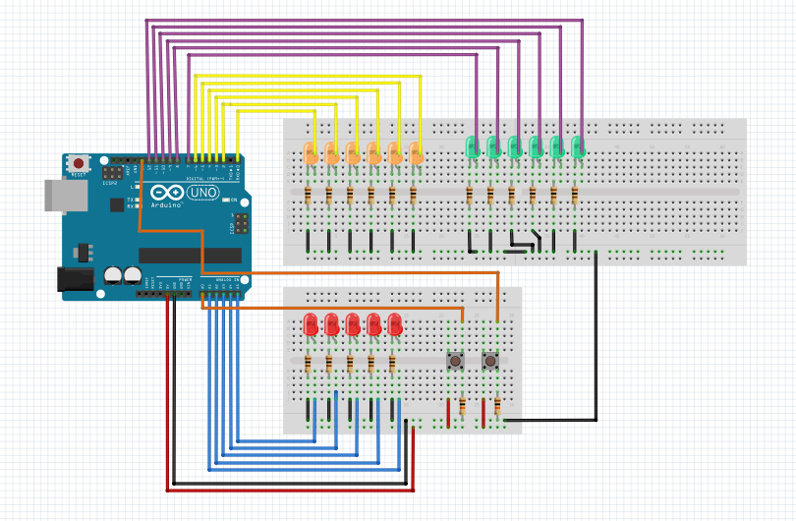
Hardware Implementation

Slide 6
Working of the project
User has to connect power supply to the Arduino.
Hardware and code has to be integrated using Arduino IDE.
When the code is uploaded, time starts from 1st second and LEDs start glowing in a binary manner.
User can change the mode to stop watch by pressing on the red button.
In stop watch mode, user can start, resume and reset the time.
All operations done using buttons will be displayed in the form of text on output terminal of the Aurdino IDE.

Slide 7
Code logic (Main loop)
void loop(void) {
/* mode selection clock, stopwatch and idle mode */
if(digitalRead(A0) == HIGH){
newcount1 = count1 + 1;
if(newcount1!= count1){
switch(newcount1){
case 1: Modeclock = true; // for clock mode to operate
ModeSW = false;
TimeRun = true;
Serial.println("Mode: Clock");
Clock = {0,0,0};
count2 = 0;
newcount2 = 0;
break;
case 2: ModeSW = true; // for stopwatch mode to operate
TimeRun = true;
Modeclock = false;
Serial.println("Mode: Stopwatch");
StopWatch = { 0, 0, 0 };
break;
default: // do nothing
Modeclock = false;
ModeSW = false;
StopWatch = { 0, 0, 0 }; TimeRun = true;
newcount1 = 0;
count2 = 0;
newcount2 = 0;
Serial.println("Mode: Idle!, Please select mode to start again");

Slide 8
Code logic
/* function selection in stopwatch i.e., pause,resume and reset */
if(digitalRead(13)== HIGH){
newcount2 = count2 + 1;
if(newcount2!= count2){
if (ModeSW){
switch(newcount2){
case 1: TimeRun = false; //
Serial.println("Stopwatch paused!!!");
break;
case 2: TimeRun = true;
Serial.println("Stopwatch resumed!!!");
break;
default:
StopWatch = { 0, 0, 0 };
TimeRun = true;
newcount2 = 0;
Serial.println("Stopwatch resetted!!!");
break;
}
}
count2 = newcount2;
}
}

Slide 9
Thanks for your attendance
Participants:
Varshitha Jayadev
Matriculation number: 64216
Pranav Yajaman Shivakumar
Matriculation number: 64330
Contact:
varshitha.jayadev@tu-ilmenau.de
pranav.yajaman-shivakumar@tu-ilmenau.de

